Slide 1


Data Structures
Week3_Lecture 1
Arrays data structures
Subhan Ullah, PhD
subhan.ullah@nu.edu.pk
BS(Cybersecurity) Fall-2023

Slide 2
Agenda
Arrays data structure
Arrays operations
Arrays Searching
Arrays Sorting

Slide 3
Arrays data structure
Array Definition:
An array is a collection of elements of the same type placed in contiguous memory locations that can be individually referenced by using an index to a unique identifier. Or
Variables to hold multiple values of same data-type
Values are stored in adjacent memory locations
The elements of the array are referenced by an index
Index values are ‘n’ consecutive numbers
Arrays exists in most programming languages and operations of this data structure are already implemented by those programming languages

Slide 4
Arrays characteristics
Each array element occupies the same number of memory cells (bytes)
Array data structure is used when the number of elements are fixed
Operations like traversal, searching and sorting can be easily performed on Array
The number of elements in an array is called the Length or Size of the Array
The size of array is specified at creation or declaration time of the array

Slide 5
Arrays declaration
Array declaration requires a data-type, a name and a “constant” size of the array
data_type array_name [array_size]
Data type: can be any valid data type
Name: The rules of variable naming convention apply to array names
Size: defines how many values can be stored in the array
The size of the array should be a precise number
Example
Declared using [] operator: int tests[5];

Slide 6
Arrays memory (RAM) layout

Slide 7
Size of an array
The size of an array is (number of elements) * (size of each element) Or
The size of an array is: the total number of bytes allocated for it
(number of elements) * (number of bytes for each element)
Examples: int tests[5];
is an array of 20 bytes, assuming 4bytes for an int
long double measures[10] is an array of 80 bytes, assuming 8 bytes for a long double
The smallest index of an array is called LowerBound, the largest index is called UpperBound
Size of array = Upper Bound –Lower Bound + 1

Slide 8
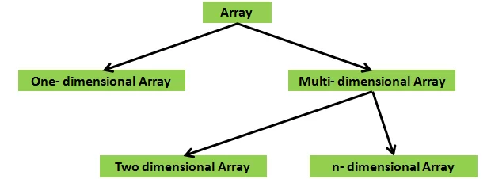
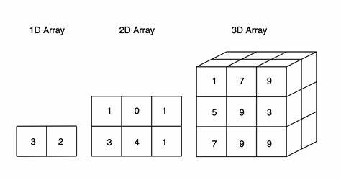
Types of the array
One dimensional array (1D array): The one-dimensional arrays stores values in the form of a list or Vector
Multi-dimensional array: (arrays of arrays) stores the value in the form of a matrix
Two dimensional array or 2D array
(example: Table)
Three dimensional arrays or 3D array
(example: Box)

Slide 9
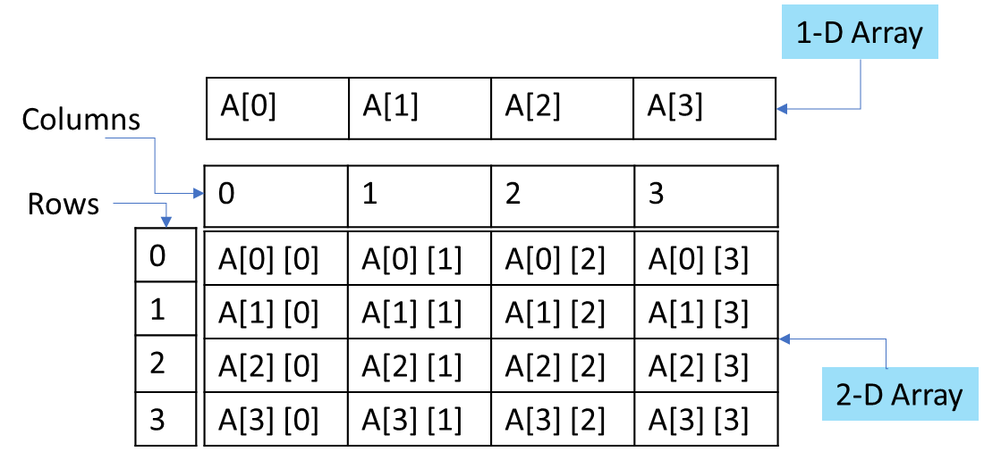
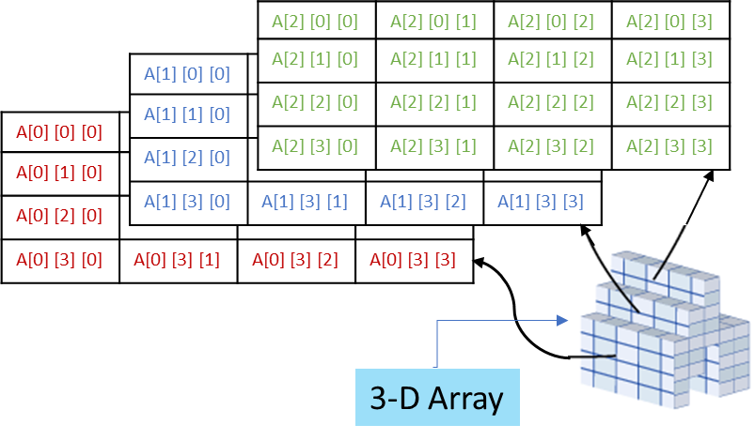
Arrays Dimensions
A dimension is a direction in which you can vary the specification of an array's elements
And index or subscript is used to specify an element of an array for each of its dimensions
The elements are contiguous along each dimension from index 0 through the highest index for that dimension
Notes:
Rows major and column major arrays

Slide 10
Addressing in an array
As size of each element in an array is same, the computer, therefore, does not need to know address of each element in advance
Address of each element can be calculated during run time using index number and the Base Address of the array
The base address of the array is always known and is represented by the name of the array
Address calculation:
The address of the first location of an array B is called base address of B, and is denoted by Base(B)

Slide 11
Addressing in an array
Suppose e size is the memory size of each element
Then address of the B[0] element is Base(B)
Address of B[1] element would be Base(B) + esize
Address of B[2] would be Base(B) + 2 * esize
So the general expression to reference address of B[i] would be Base(B) + I * esize
What will happen if index of an array starts with 1 instead of 0 in any programming language?
The formula to access B[i] becomes
Base(B)+ (i –1) * esize

Slide 12
Array Operations
Insertion
Operation of adding another element to an array
How many steps in terms of n (number of elements in array)?
At the end
In the middle
In the beginning
n steps at maximum (move items to insert at given location)
Deletion
Operation of removing one of the elements from an array
How many steps in terms of n (number of elements in array)?
At the end
In the middle
In the beginning
n steps at maximum (move items back to take place of deleted item)

Slide 13
Array Operations: Search Algorithms
Operation of locating a specific data item in an array
Successful: If location of the searched data is found
Unsuccessful: Otherwise
Complexity (or efficiency) of a search algorithm
Number of comparisons f(n) required to locate data within array
n is the number of elements within array
Two algorithms for searching in arrays
Linear search (or sequential search)
Binary search

Slide 14
Linear Search
Very intuitive and simple algorithm
Linear search: Search array for a key value
Compare each element of array with key value
Start at one end, go to other
Algorithm works as follows:
Starts from the first element of the array
Uses a loop to sequentially step through an array
Compares each element with the data item being searched
Stops when data item is found or end of array is reached
https://www.cs.usfca.edu/~galles/visualization/Search.html

Slide 15
Linear Search example
#include <iostream>
using namespace std;
int main(){
int input[100], count, i, num;
cout << "Enter Number of Elements in Array\n";
cin >> count;
cout << "Enter " << count << " numbers \n";
// Read array elements
for(i = 0; i < count; i++){
cin >> input[i];
}
cout << "Enter a number to search in Array\n";
cin >> num;

Slide 16
Linear Search example
// search num in inputArray from index 0 to elementCount-1
for(i = 0; i < count; i++){
if(input[i] == num){
cout << "Element found at index " << i;
break;
}
}
if(i == count){
cout << "Element Not Present in Input Array\n";
}
return 0;}
Output:
Enter Number of Elements in Array
6
Enter 6 numbers
8 4 7 1 3 9
Enter a number to serach in Array
3
Element found at index 4
-------------------------------------------
Enter Number of Elements in Array
6
Enter 6 numbers
8 4 7 1 3 9
Enter a number to serach in Array
2
Element Not Present in Input Array

Slide 17
Linear Search Algorithm
// numElems – maximum number of elements in the array
// value – integer data (item) to be searched
// position – array subscript that holds value (if success)
// -1 if value not found
int searchList(int list[], int numElems, int value)
{
int index = 0; // Used as a subscript to search array
int position = -1; // To record position of search value
bool found = false; // Flag to indicate if the value was found
while (index < numElelments && !found)
{
if (list[index] == value) {
found = true;
position = index;
}
index++;
}
return position;
}

Slide 18
Calling Function searchList
#include <iostream>
using namespace std;
// Function prototype
int searchList(int [], int, int);
const int arrSize = 5;
int main()
{
int tests[arrSize] = {87, 75, 98, 100, 82};
int result;
result = searchList(tests, arrSize, 100);
if (result == -1)
cout << "You did not earn 100 points on any test\n";
else{
cout << "You earned 100 points on test ";
cout << (result + 1) << endl;
}
}
Program Output:
You earned 100 points on test 4.

Slide 19
Discussion
Advantage of linear search is its simplicity
Easy to understand
Easy to implement
Does not require array to be in order (i.e., sorted)
Useful for small and unsorted arrays
Inefficient: If search key not present, examines every element
Disadvantage is its efficiency (or complexity)
Worst case complexity: f(n) = n+1
Number of steps are proportional to number n of elements in an array
If there are 20,000 items in an array
Searched data item is stored in the 19,999th element
Entire array has to be searched
Notes:
Best case= O(1)
Best case= O(n)
Best case= O(n+1/2) -→ average case = sum of all case/ number of cases → 1+2+3+4+5…n →n(n+1)/2n

Slide 20
Home work

Slide 21
1 // code 16
2 // Linear search of an array.
3 #include <iostream>
4
5 using std::cout;
6 using std::cin;
7 using std::endl;
8
9 int linearSearch( const int [], int, int ); // prototype
10
11 int main()
12 {
13 const int arraySize = 100; // size of array a
14 int a[ arraySize ]; // create array a
15 int searchKey; // value to locate in a
16
17 for ( int i = 0; i < arraySize; i++ ) // create some data
18 a[ i ] = 2 * i;
19
20 cout << "Enter integer search key: ";
21 cin >> searchKey;
22
23 // attempt to locate searchKey in array a
24 int element = linearSearch( a, searchKey, arraySize );
25
Takes array, search key, and array size.

Slide 22
26 // display results
27 if ( element != -1 )
28 cout << "Found value in element " << element << endl;
29 else
30 cout << "Value not found" << endl;
31
32 return 0; // indicates successful termination
33
34 } // end main
35
36 // compare key to every element of array until location is
37 // found or until end of array is reached; return subscript of
38 // element if key or -1 if key not found
39 int linearSearch( const int array[], int key, int sizeOfArray )
40 {
41 for ( int j = 0; j < sizeOfArray; j++ )
42
43 if ( array[ j ] == key ) // if found,
44 return j; // return location of key
45
46 return -1; // key not found
47
48 } // end function linearSearch
Enter integer search key: 36
Found value in element 18
Enter integer search key: 37
Value not found

Slide 23
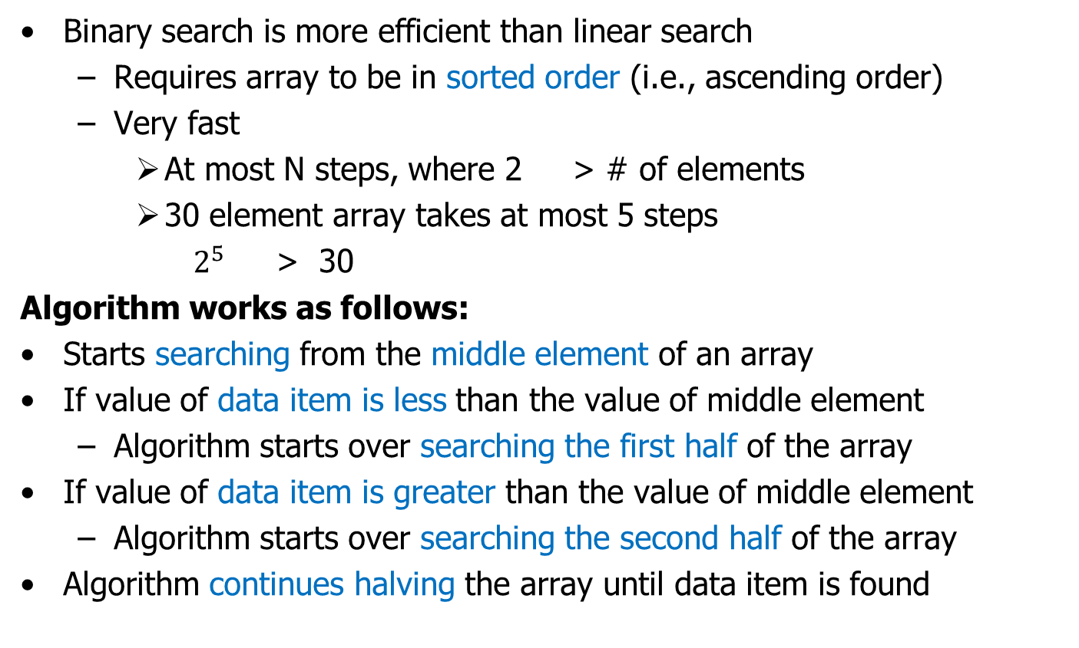
Binary Search
Binary search is more efficient than linear search
Requires array to be in sorted order (i.e., ascending order)
Very fast
At most N steps, where 2 > # of elements
30 element array takes at most 5 steps
$2^{5}$ > 30
Algorithm works as follows:
Starts searching from the middle element of an array
If value of data item is less than the value of middle element
Algorithm starts over searching the first half of the array
If value of data item is greater than the value of middle element
Algorithm starts over searching the second half of the array
Algorithm continues halving the array until data item is found

Slide 24

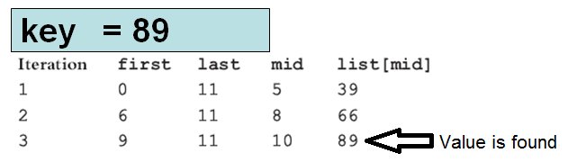
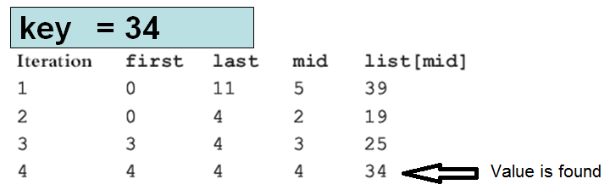
Binary Search Example
Sorted list for binary search
https://yongdanielliang.github.io/animation/web/BinarySearchNew.html

Slide 25
Binary Search Algorithm
// numElems – maximum number of elements in the array
// value – integer data (item) to be searched
// position – array subscript that holds value (if success)
// -1 if value not found
int binarySearch(int array[], int numelems, int value)
{
int first = 0, last = numelems - 1, middle, position = -1;
bool found = false;
while (!found && first <= last){
middle = (first + last) / 2; // Calculate mid point
if (array[middle] == value) { // If value is found at mid
found = true;
position = middle;
}
else if (array[middle] > value) //If value is in lower half
last = middle - 1;
else
first = middle + 1; // If value is in upper half
}
return position;
}

Slide 26
Calling Function binary Search
#include <iostream>
using namespace std;
// Function prototype
int binarySearch(int [], int, int);
const int arrSize = 20;
int main()
{
int empIDs[arrSize] = {101, 142, 147, 189, 199, 207, 222, 234, 289, 296,
310, 319, 388, 394, 417, 429, 447, 521, 536, 600};
int result, empID;
cout << "Enter the Employee ID you wish to search for: ";
cin >> empID;
result = binarySearch(empIDs, arrSize, empID);
if (result == -1)
cout << "That number does not exist in the array.\n";
else {
cout << "That ID is found at element " << result;
cout << " in the array\n";
}
}
Program Output:
Enter the Employee ID you wish to search for: 199
That ID is found at element 4 in the array

Slide 27
Efficiency Of Binary Search
Much more efficient than the linear search
How long does this take (worst case)?
If the list has 8 elements
It takes 3 steps (2³ = 8)
If the list has 16 elements
It takes 4 steps (2⁴ = 16)
If the list has 64 elements
It takes 6 steps (2⁶ = 64)
Worst case complexity: f(n) = log₂(n)
Takes log₂ n steps

Slide 28
Discussion
Advantage of linear search is its simplicity
Easy to understand
Easy to implement
Does not require array to be in order (i.e., sorted)
Disadvantage is its efficiency (or complexity)
If there are 20,000 items in an array
Searched data item is stored in the 19,999th element
Entire array has to be searched
Worst case complexity: f(n) = n+1
Number of steps are proportional to number n of elements in an array
https://blog.penjee.com/wp-content/uploads/2015/04/binary-and-linear-search-animations.gif

Slide 29
Linear (Sequential) and Binary search visualization

Slide 30
Home work

Slide 31
1 // code 17
2 // Binary search of an array.
3 #include <iostream>
4
5 using std::cout;
6 using std::cin;
7 using std::endl;
8
9 #include <iomanip>
10
11 using std::setw;
12
13 // function prototypes
14 int binarySearch( const int [], int, int, int, int );
15
16 int main()
17 {
18 const int arraySize = 15; // size of array a
19 int a[ arraySize ]; // create array a
20 int key; // value to locate in a
21
22 for ( int i = 0; i < arraySize; i++ ) // create some data
23 a[ i ] = 2 * i;
24

Slide 32
25 cout << "Enter a number between 0 and 28: ";
26 cin >> key;
27
28 // search for key in array a
29 int result = binarySearch( a, key, 0, arraySize - 1, arraySize );
30
31 // display results
32 if ( result != -1 )
33 cout << '\n' << key << " found in array element "
34 << result << endl;
35 else
36 cout << '\n' << key << " not found" << endl;
37
38 return 0; // indicates successful termination
39
40 } // end main
41
42 // function to perform binary search of an array
43 int binarySearch( const int b[], int searchKey, int low,
44 int high, int size )
45 {
46 int middle;

Slide 33
47 // loop until low subscript is greater than high subscript
48 while ( low <= high ) {
49
50 // determine middle element of subarray being searched
51 middle = ( low + high ) / 2;
52
53 // if searchKey matches middle element, return middle
54 if ( searchKey == b[ middle ] ) // match
55 return middle;
56
57 else
58
59 // if searchKey less than middle element,
60 // set new high element
61 if ( searchKey < b[ middle ] )
62 high = middle - 1; // search low end of array
63
64 // if searchKey greater than middle element,
65 // set new low element
66 else
67 low = middle + 1; // search high end of array
68 }
69
70 return -1; // searchKey not found
71
72 } // end function binarySearch
Determine middle element
Use the rule of binary search:
If key equals middle, match
If less, search low end
If greater, search high end
Loop sets low, middle and high dynamically. If searching the high end, the new low is the element above the middle.

Slide 34
Enter a number between 0 and 28: 6
6 found in array element 3
Enter a number between 0 and 28: 25
25 not found
Enter a number between 0 and 28: 8
8 found in array element 4

Slide 35
Array Operations
How to insert an item?
How many steps in terms of n (number of elements in array)?
n steps at maximum (move items to insert at given location)
How to delete an item?
How many steps in terms of n (number of elements in array)?
n steps at maximum (move items back to take place of deleted item)

Slide 36


